Slide 1



Chapter 12: File System Implementation
File System Structure
File System Implementation
Directory Implementation
Allocation Methods
Free-Space Management
Efficiency and Performance
Recovery
Log-Structured File Systems
NFS

Slide 2
File-System Structure
File structure
  Logical storage unit
  Collection of related information
File system resides on secondary storage (disks).
File system organized into layers.
File control block – storage structure consisting of information about a file.

Slide 3
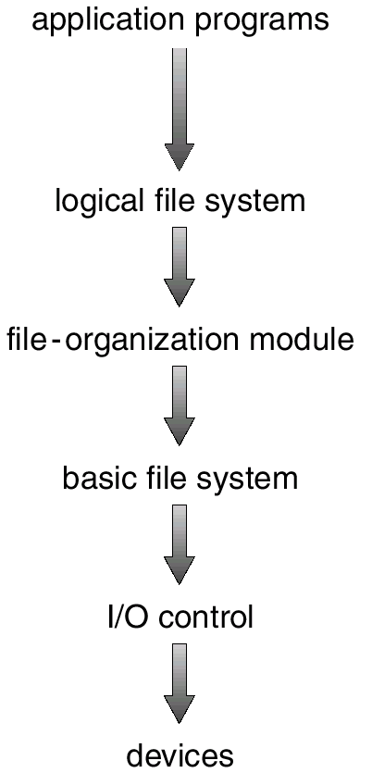
Layered File System

Slide 4
1. The device driver is at lowest layer .It consists hardware specific instructions which will be given to I/O controller.
2 I/O controller tells the memory the detail of device driver and find the location from which the action will be taken
3.Basic file system : From appropriate device driver it reads or writes physical block to or from the disk .Each physical block is identified by numeric address .eg drive no.1 ,cylinder no. 23, track no.2 ,sector no 10 etc.
4 .File organization module.It knows about the file and their logical blocks as well as physical blocks ,this module also includes the un allocated block and provide these block to file organization module.
5.Logical file system: It manages meta data ,information abt data ,includes all file sys.str. Excluding actual data .It consists ownership ,permission ,location of the file content
6.Application program: using which we can access the file.

Slide 5
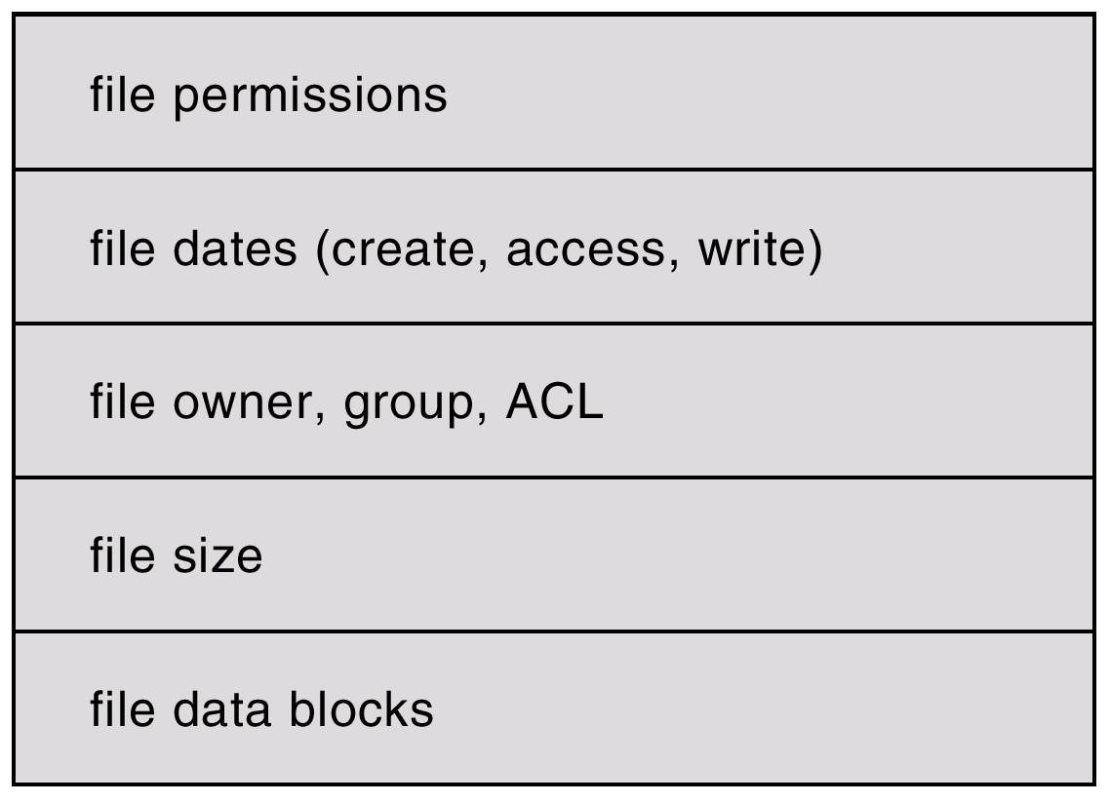
A Typical File Control Block
Access control list

Slide 6
In-Memory File System Structures
The following figure illustrates the necessary file system structures provided by the operating systems.
Figure 12-3(a) refers to opening a file.
Figure 12-3(b) refers to reading a file.

Slide 7
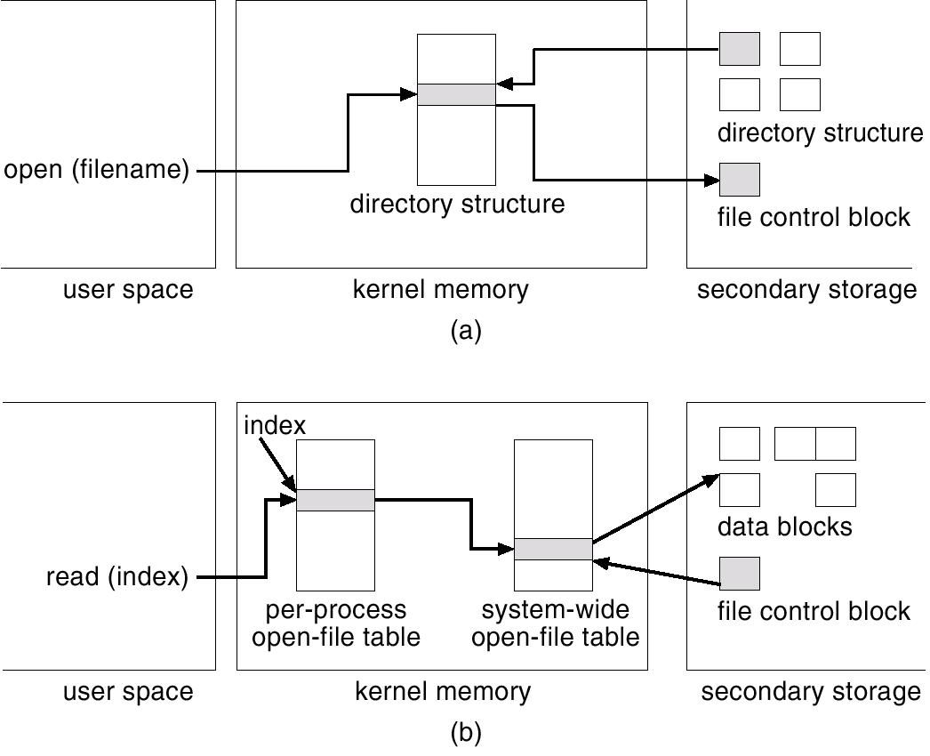
In-Memory File System Structures

Slide 8
a) The file system open file table which holds the inode no. and other information for file and directories .It also holds the info. Abt n/w comm. And other devices .All info. Abt. Open will be there in memory except the actual data of file . b) Here the file will be opened with actual data with respect to its control block or access permission.

Slide 9
Virtual File Systems
Virtual File Systems (VFS) provide an object-oriented way of implementing file systems.
VFS allows the same system call interface (the API) to be used for different types of file systems.
The API is to the VFS interface, rather than any specific type of file system.

Slide 10
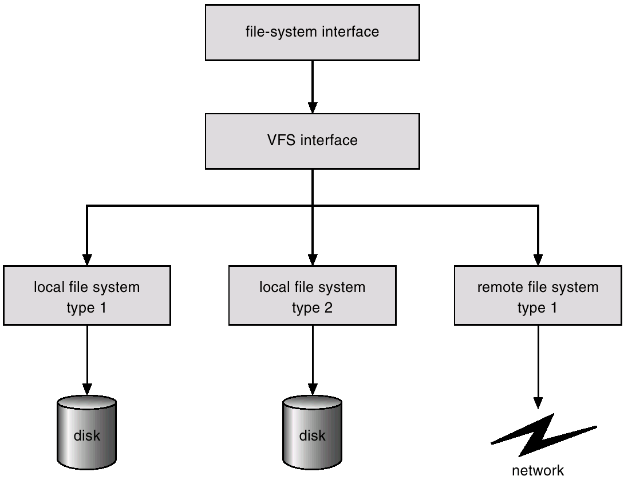
Schematic View of Virtual File System

Slide 11
First layer is file sys. Interface based on read ,write and close calls and file descriptors
Second layer is VFS It serves 2 important functions.
1) It separates file sys- generic operations from their implementation by defining VFS interface.
2) VFS based on file representation structure called vnode that contains numerical file designator for network file
So VFS distinguishes local files ,from remote ones and it is further divided into their file types.

Slide 12
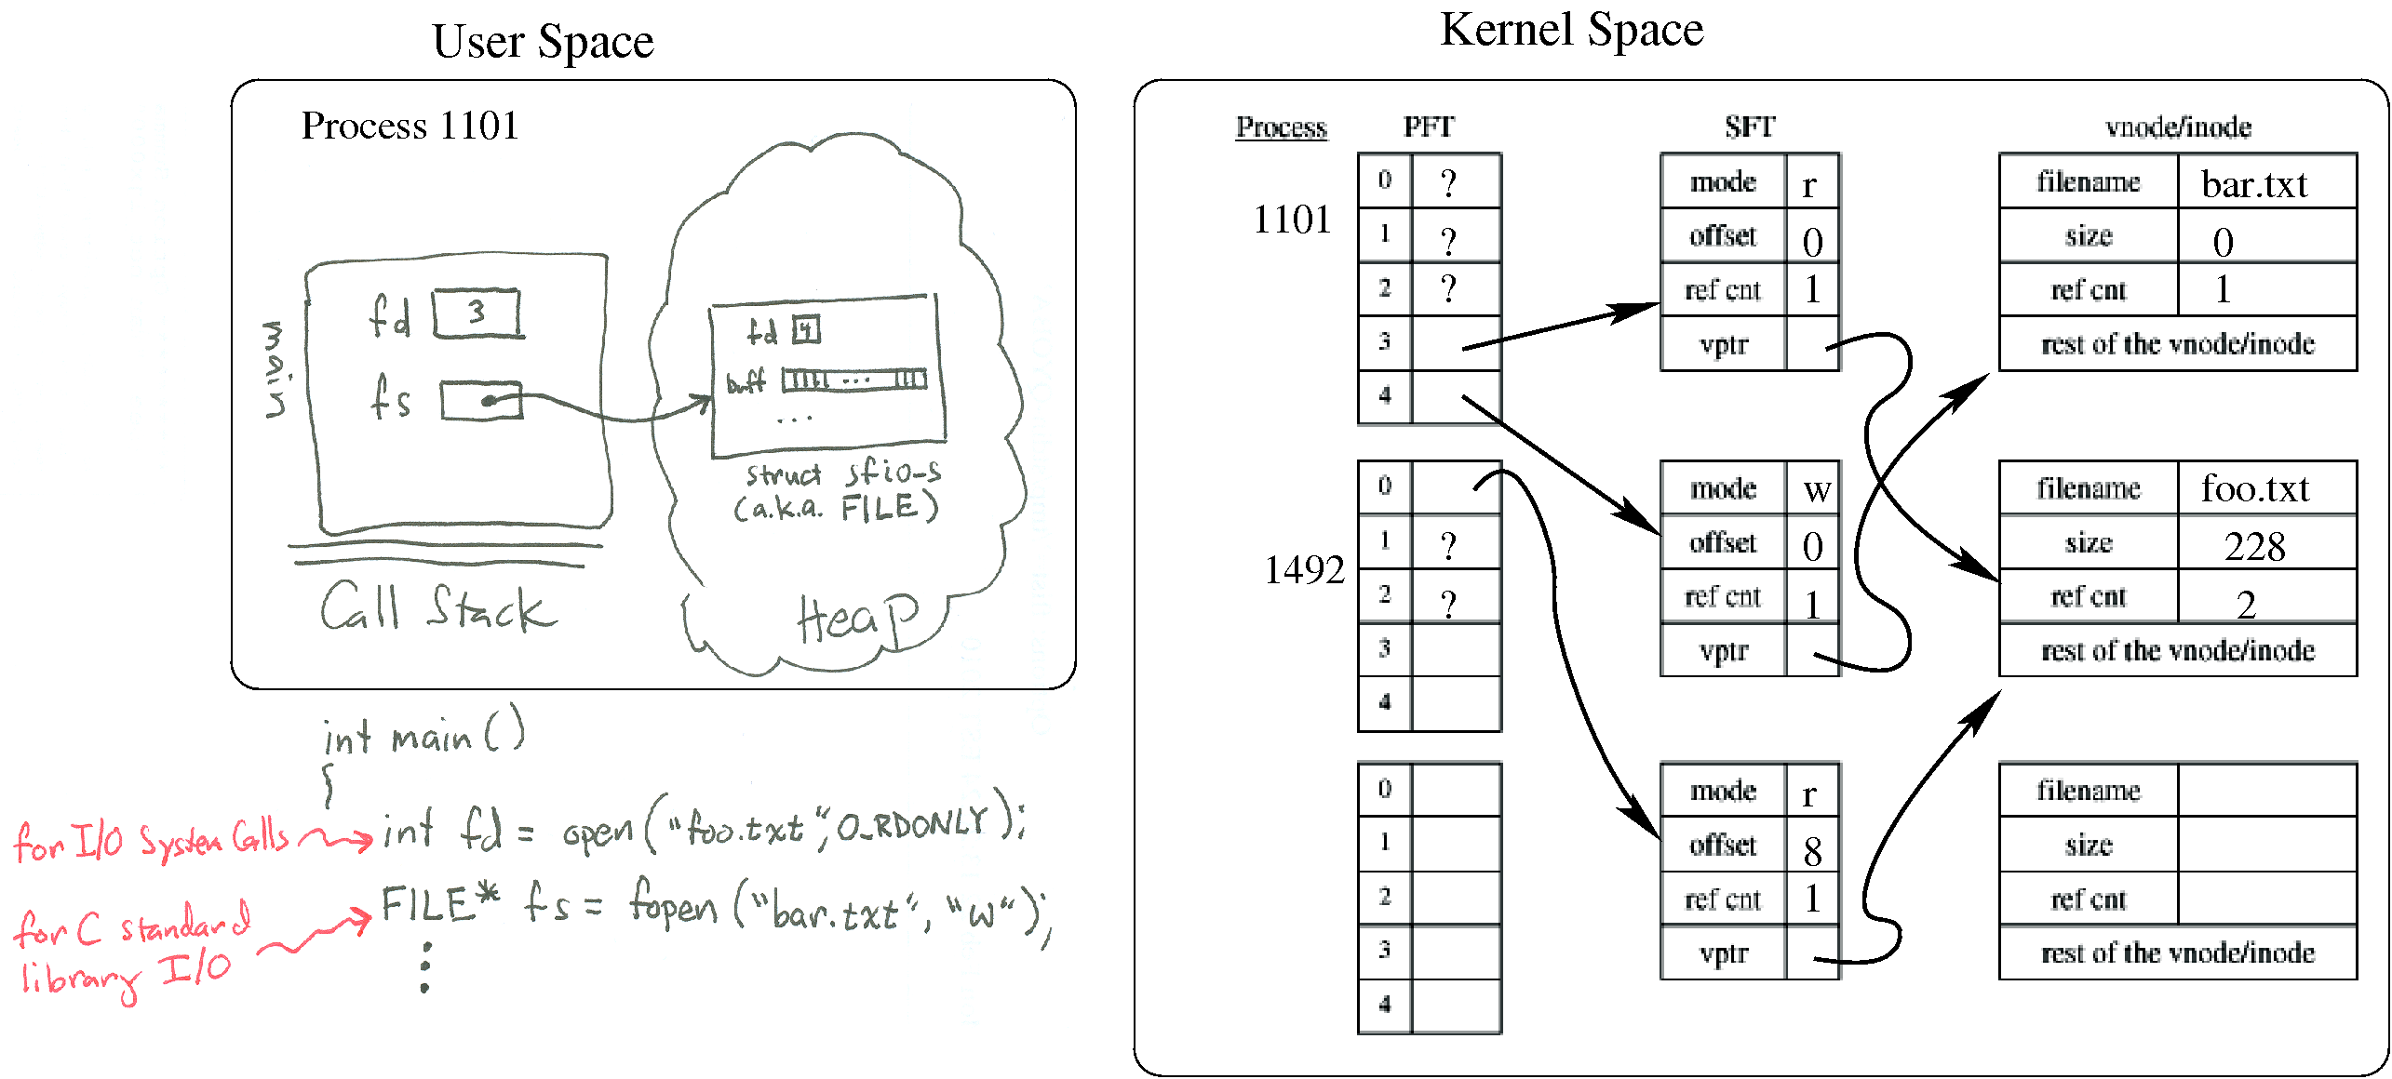
A virtual node (v-node) represents access to an object within a virtual file system. ... When a user attempts to open or create a file, if the VFS containing the file already has a v-node representing that file, a use count in the v-node is incremented and the existing v-node is used. Otherwise, a new v-node is created.

Slide 13
Directory Implementation
Linear list of file names with pointer to the data blocks.
  simple to program
  time-consuming to execute
  Requires linear search to find file
  To create new it first search list for existing or not
  To delete also same search
  Sorting may help to search fast,B tree and binary search tree can decrease the average search time .
Hash Table – linear list with hash data structure.
  It takes value computed from filename and returns the pointer to that file in linear list.so,
  decreases directory search time
  collisions – situations where two file names hash to the same location
  fixed size and hash function depends on it.

Slide 14
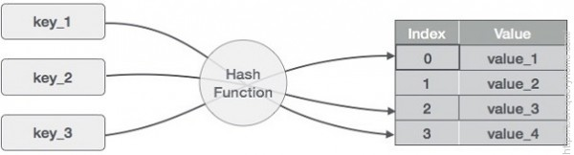
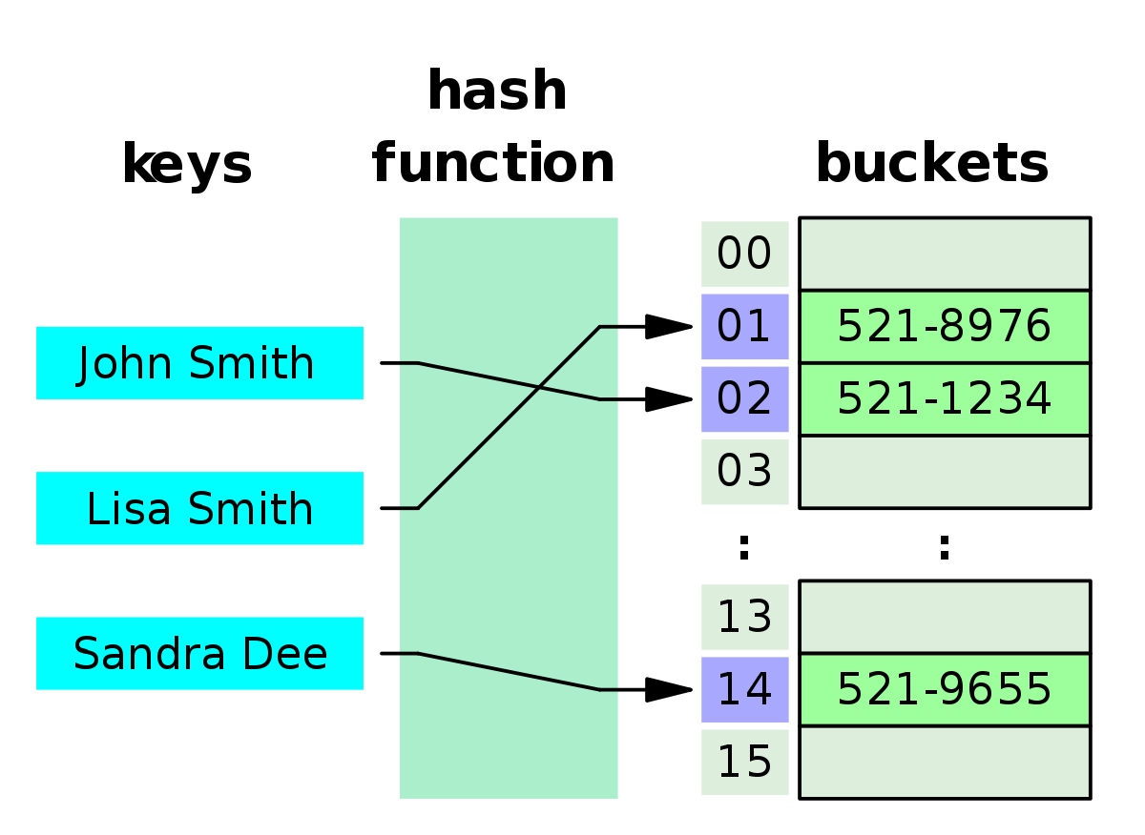

Slide 15
Allocation Methods
An allocation method refers to how disk blocks are allocated for files:
Contiguous allocation
Linked allocation
Indexed allocation

Slide 16
Contiguous Allocation
Each file occupies a set of contiguous blocks on the disk.
Linear ordering of disk address .
Simple – only starting location (block #) and length (number of blocks) are required.
Random access.
Access is easy,Direct access to a block I of file starts at block b will be at block b+I, so here sequential and direct access is easy.
Wasteful of space (dynamic storage-allocation problem).how to satisfy the n size block from free blocks ,ie.first fit or best fit strategies can be used.
Files cannot grow.When file is created total amount of space is allocated to it so further if we extend the file it may not possible.

Slide 17
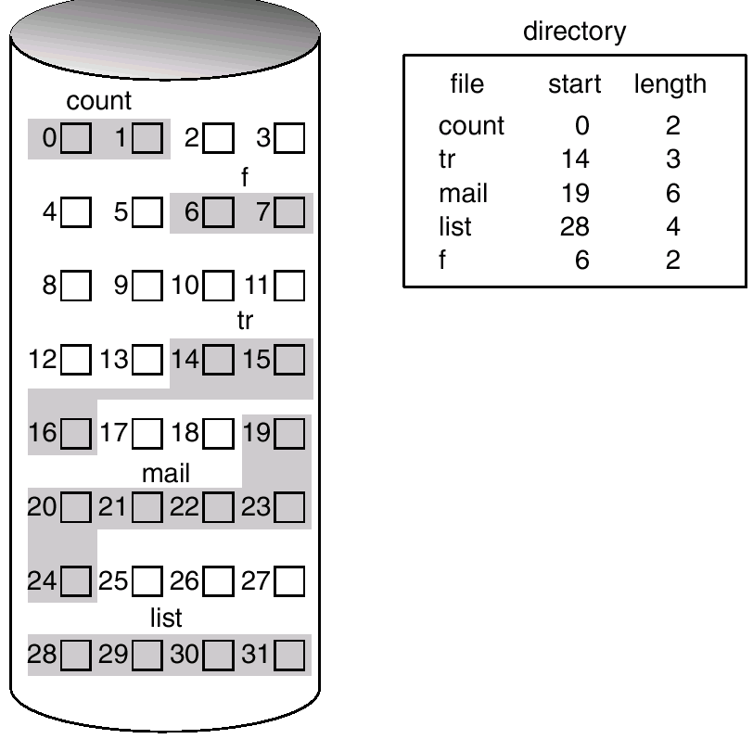
Contiguous Allocation of Disk Space
Here name of file eg, count starts from block no. 0 and it’s length is of 2 blocks so in figure it’s two blocks 0 and 1 is shown.

Slide 18
Extent-Based Systems
Many newer file systems (I.e. Veritas File System) use a modified contiguous allocation scheme.
Extent-based file systems allocate disk blocks in extents.
An extent is a contiguous block of disks. Extents are allocated for file allocation. A file consists of one or more extents.
When the amount of memory is not large enough another chunk of memory is an extent is added to that chunk.That extent is added to the initial location and accordingly the block count is managed.

Slide 19
Linked Allocation
Each file is a linked list of disk blocks: blocks may be scattered anywhere on the disk.
block =
pointer

Slide 20
Linked Allocation (Cont.)
Simple – need only starting address
Free-space management system – no waste of space
No random access
Mapping
Q
LA/511
R
Block to be accessed is the Qth block in the linked chain of blocks representing the file.
Displacement into block = R + 1
File-allocation table (FAT) – disk-space allocation used by MS-DOS and OS/2.

Slide 21
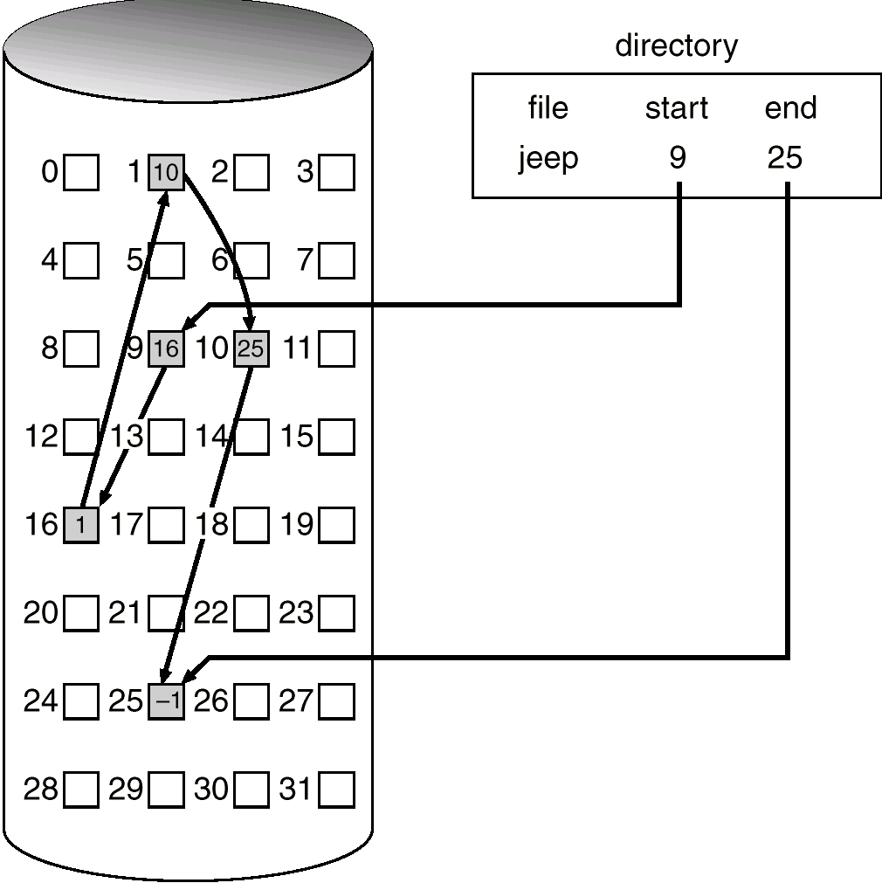
Linked Allocation

Slide 22
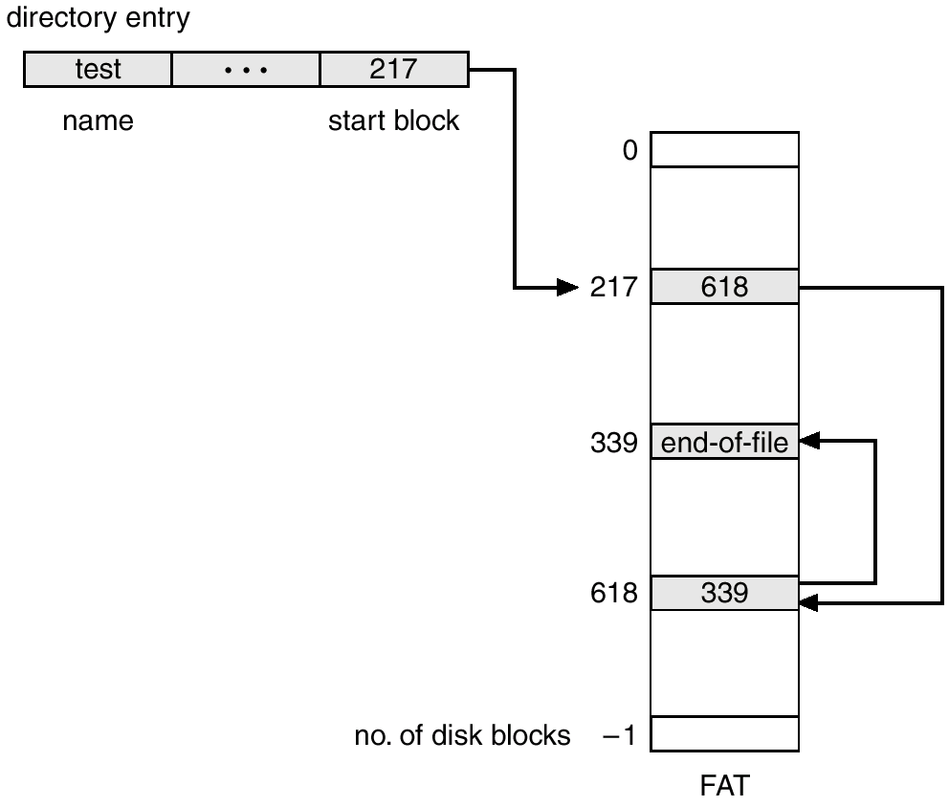
File-Allocation Table

Slide 23
Here FAT structure is shown in figure
For the Directory named test starts from 217 block and having other blocks 618 and 339 linked with each other.
Benefit here is random access time is improved because disk head can find location of any block by reading FAT.

Slide 24
Indexed Allocation
In linked allocation FAT is required ,in absence of it direct access is not possible.
Brings all pointers together into the index block.
Logical view.
index table

Slide 25
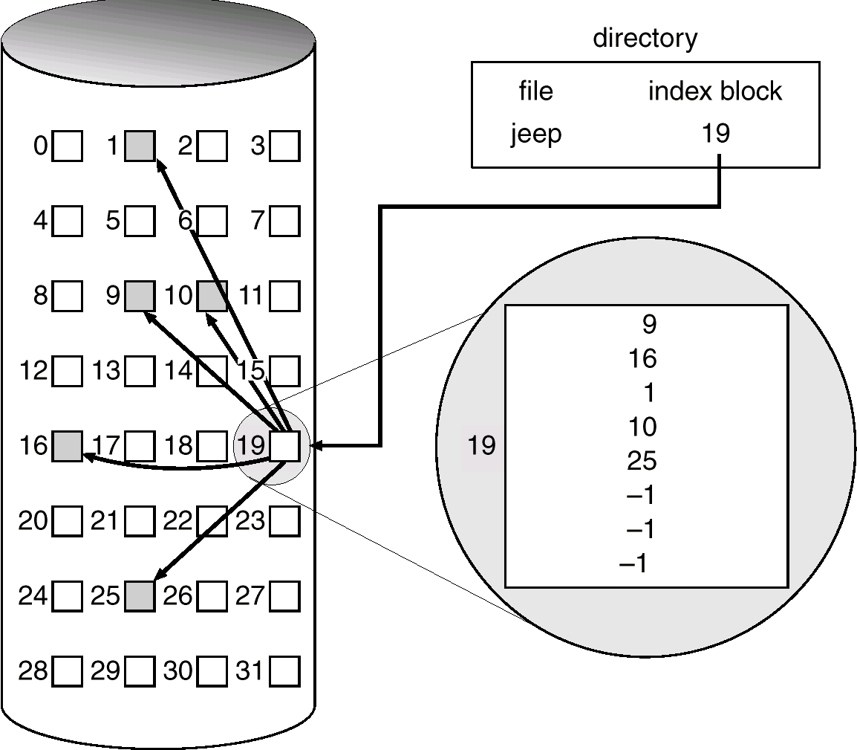
Example of Indexed Allocation

Slide 26
Indexed Allocation (Cont.)
Need index table
Random access
Dynamic access without external fragmentation, but have overhead of index block.
Mapping from logical to physical in a file of maximum size of 256K words and block size of 512 words. We need only 1 block for index table.
Q
LA/512
R
Q = displacement into index table R = displacement into block

Slide 27
Indexed Allocation – Mapping (Cont.)
Mapping from logical to physical in a file of unbounded length (block size of 512 words).
Linked scheme – Link blocks of index table (no limit on size).the block contains name of file and set of 100 disk addresses the next address is null or next block address if file is large.
Q₁
LA / (512 x 511)
R₁
Q₁ = block of index table
R₁ is used as follows:
Q₂
R₁ / 512
R₂
Q₂ = displacement into block of index table
R₂ displacement into block of file:

Slide 28
Indexed Allocation – Mapping (Cont.)
Two-level index (maximum file size is 512³)
Q₁
LA / (512 x 512)
R₁
Q₁ = displacement into outer-index
R₁ is used as follows:
Q₂
R₁ / 512
R₂
Q₂ = displacement into block of index table
R₂ displacement into block of file:

Slide 29
Indexed Allocation – Mapping (Cont.)
…
outer-index
index table
file

Slide 30
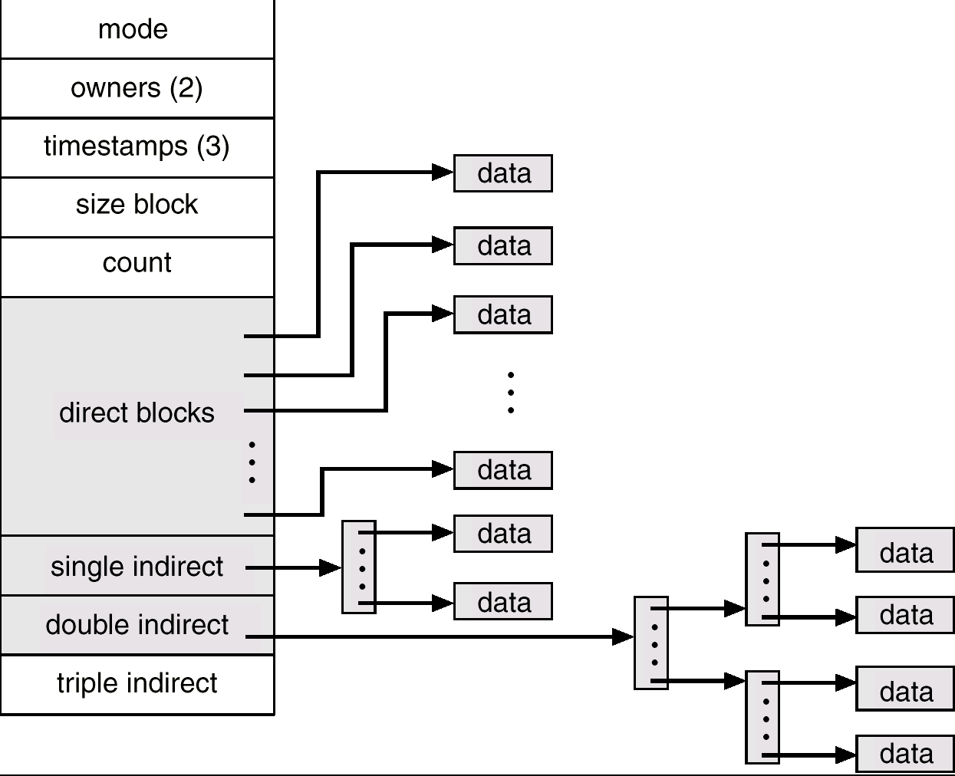
Combined Scheme: UNIX (4K bytes per block)

Slide 31
Unix File System
Here first 15 pointers of the index block in file’s inode ,
First 12 are direct blocks which contains address of block which contain data .
Next 3 are indirect address pointers
Single indirect- it contains not data but the addresses of blocks which contain data.
Double indirect- Which contains addresses of blocks which contain addresses of blocks which points to the block which contain data
3) Triple indirect- here number of blocks which can be allocated to a file exceeds amount of space by the 4 byte file pointer used by many os.

Slide 32
Free-Space Management
Bit map requires extra space. Example: block size = 2¹² bytes
disk size = 2³⁰ bytes (1 gigabyte)
n = 2³⁰/2¹² = 2¹⁸ bits (or 32K bytes)
Easy to get contiguous files
Linked list (free list)
  Cannot get contiguous space easily
  No waste of space
Grouping- free list has n free blocks,so large no. of free blocks can be easily found.
Counting-rather than keeping a list of n free block we can keep track of first free block and the n no. of free contiguous blocks follow the first block.

Slide 33
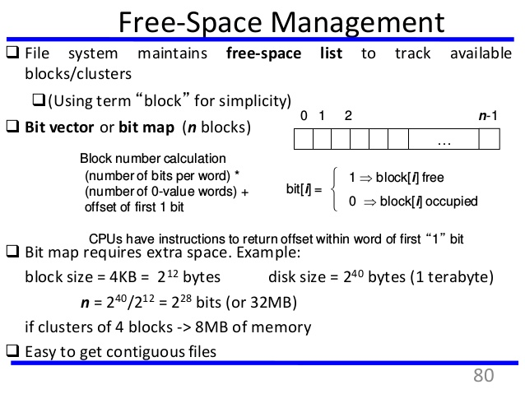

Slide 34
Free-Space Management (Cont.)
Need to protect:
  Pointer to free list
  Bit map
✔ Must be kept on disk
✔ Copy in memory and disk may differ.
✔ Cannot allow for block[i] to have a situation where bit[i] = 1 in memory and bit[i] = 0 on disk.
  Solution:
✔ Set bit[i] = 1 in disk.
✔ Allocate block[i]
✔ Set bit[i] = 1 in memory

Slide 35
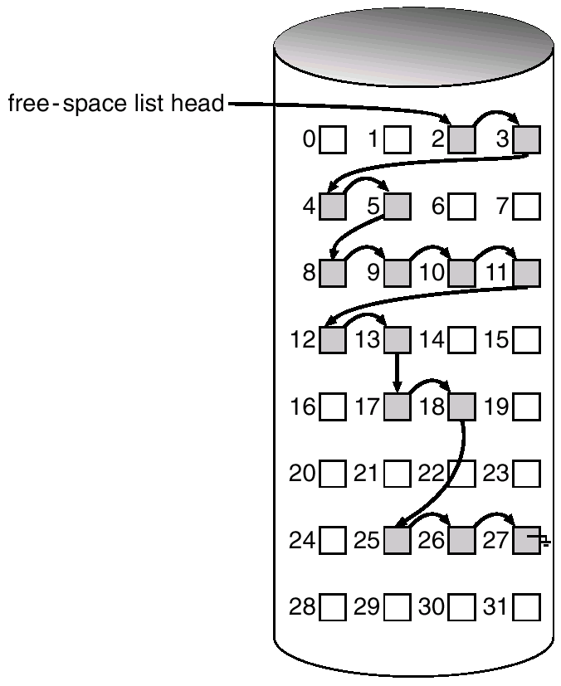
Linked Free Space List on Disk

